Slide 1

Parallel & Distributed Computing
Virtualization-II
Lecture 13/1
Farhad M. Riaz
Farhad.Muhammad@numl.edu.pk
Department of Computer Science
NUML, Islamabad

Slide 2
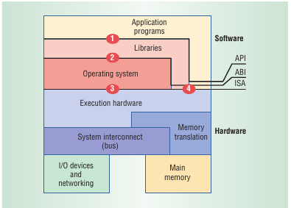
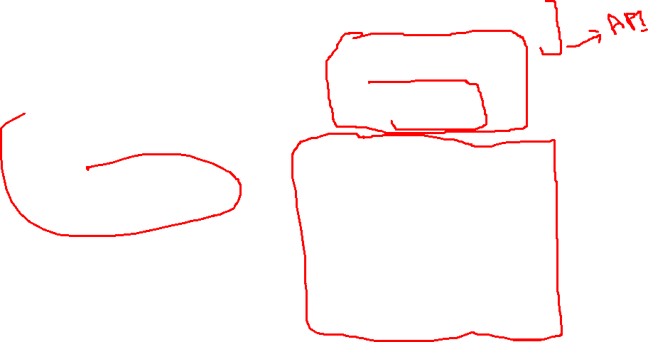
Computer System Architecture
Interfaces at or near the H/w S/w boundary :-
  ISA – Instruction Set Architecture.
  API – Application Program Interface
  ABI – Application Binary Interface

Slide 3
Virtualized Environments
Three major components of Virtualized Environments
  Guest
    System component that interacts with Virtualization Layer.
  Host
    Original environment where guest runs.
  Virtualization Layer
    Recreate the same or different environment where guest will run.

Slide 4
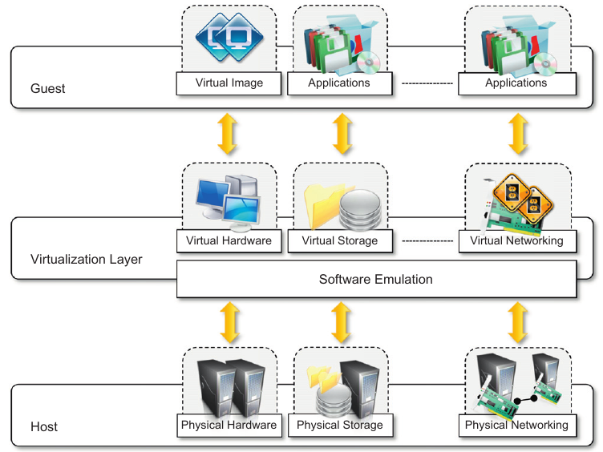
Virtualization Reference Model

Slide 5
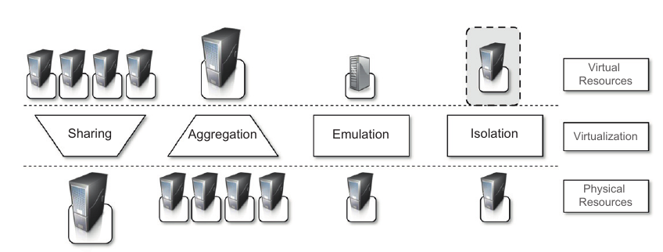
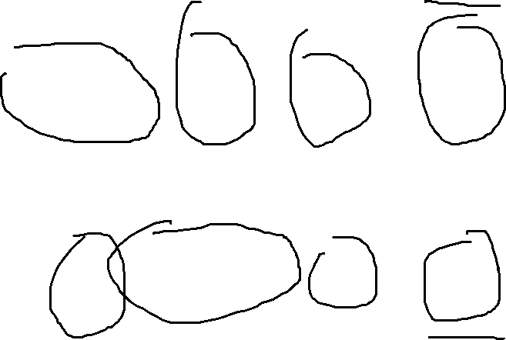
Managed Execution

Slide 6
Taxonomy of Virtualization Techniques
Virtualization is mainly used to emulate execution environment , storage and networks.
Execution Environment classified into two :-
  Process-level
    implemented on top of an existing operating system.
  System-level
    implemented directly on hardware and do not or minimum requirement of existing operating system

Slide 7
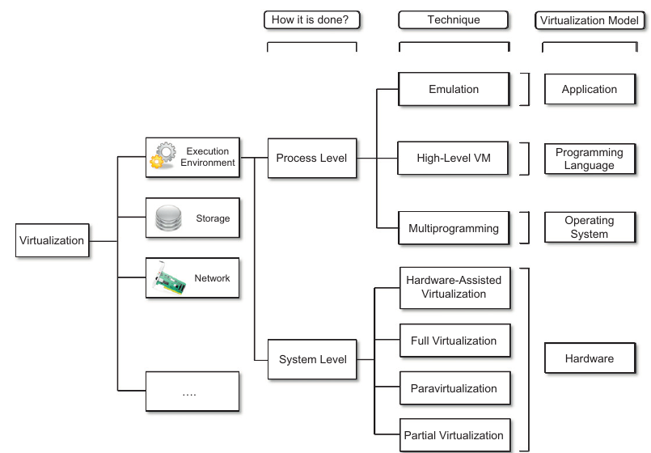
Taxonomy of virtualization

Slide 8
Machine Reference Model
It defines the interfaces between the levels of abstractions, which hide implementation details.
Virtualization techniques actually replace one of the layers and intercept the calls that are directed towards it.

Slide 9
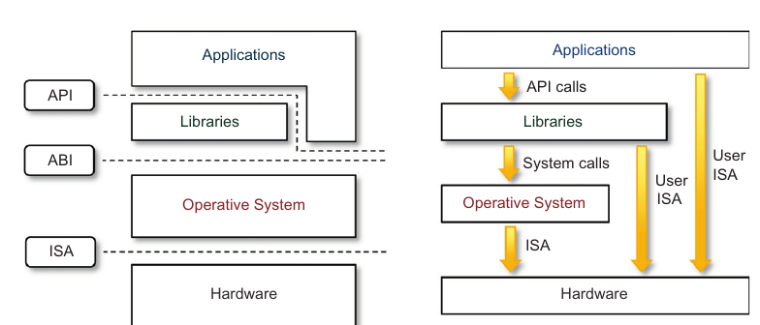
Machine Reference Model [Cont.]
Hardware is expressed in terms of the Instruction Set Architecture (ISA).
  ISA for processor, registers, memory and the interrupt management.
Application Binary Interface (ABI) separates the OS layer from the application and libraries which are managed by the OS.
  System Calls defined
  Allows portabilities of applications and libraries across OS.

Slide 10
Machine Reference Model [Cont.]
API – it interfaces applications to libraries and/or the underlying OS.
Layered approach simplifies the development and implementation of computing system.
ISA has been divided into two security classes:-
  Privileged Instructions
  Nonprivileged Instructions

Slide 11
ISA: Security Classes
Nonprivileged instructions
  That can be used without interfering with other tasks because they do not access shared resources.
  Ex. Arithmetic , floating & fixed point.
Privileged instructions
  That are executed under specific restrictions and are mostly used for sensitive operations, which expose (behavior-sensitive) or modify (control-sensitive) the privileged state.
    Behavior-sensitive – operate on the I/O
    Control-sensitive – alter the state of the CPU register.

Slide 12
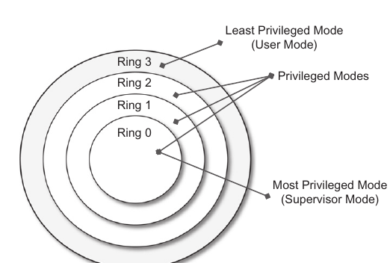
Privileged Hierarchy: Security Ring
Ring-0 is in most privileged level , used by the kernel.
Ring-1 & 2 used by the OS-level services
and , R3 in the least privileged level , used by the user.
Recent system support two levels :-
  Ring 0 – supervisor mode
  Ring 3 – user mode

Slide 13
Hardware-level virtualization
It is a virtualization technique that provides an abstract execution environment in terms of computer hardware on top of which a guest OS can be run.
It is also called as system virtualization.

Slide 14
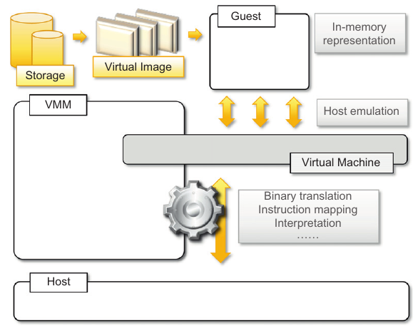
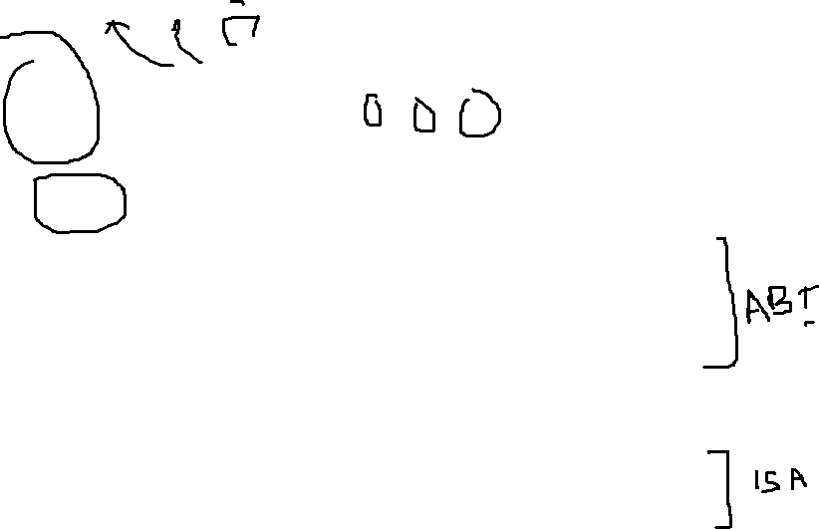
Hardware-level virtualization

Slide 15
Hypervisor
Hypervisor runs above the supervisor mode.
It runs in supervisor mode.
It recreates a h/w environment.
It is a piece of s/w that enables us to run one or more VMs on a physical server(host).
Two major types of hypervisor
  Type -I
  Type-II

Slide 16
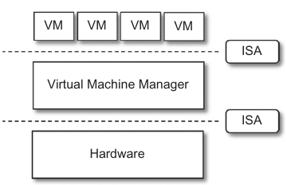

Type-I Hypervisor
It runs directly on top of the hardware.
Takes place of OS.
Directly interact with the ISA exposed by the underlying hardware.
Also known as native virtual machine.

Slide 17
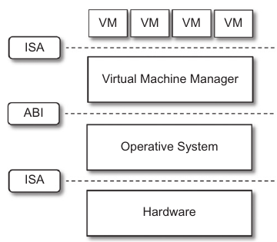

Type-II Hypervisor
It require the support of an operating system to provide virtualization services.
Programs managed by the OS.
Emulate the ISA of virtual h/w.
Also called hosted virtual machine.

Slide 18
Virtual Machine Manager (VMM)
Main Modules :-
  Dispatcher
    Entry Point of VMM
    Reroutes the instructions issued by VM instance.
  Allocator
    Deciding the system resources to be provided to the VM.
    Invoked by dispatcher
  Interpreter
    Consists of interpreter routines
    Executed whenever a VM executes a privileged instruction.
    Trap is triggered and the corresponding routine is executed.

Slide 19
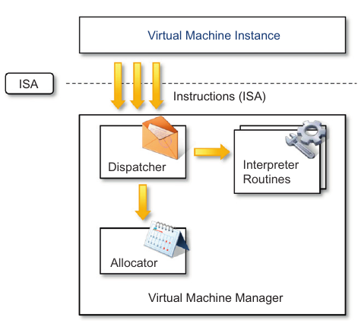
Virtual Machine Manager (VMM)

Slide 20
Criteria of VMM
Equivalence
  same behaviour as when it is executed directly on the physical host.
Resource control
  it should be in complete control of virtualized resources.
Efficiency
  a statistically dominant fraction of the machine instructions should be executed without intervention from the VMM

Slide 21
What is containerization?
Containerization is a software deployment process that bundles an application’s code with all the files and libraries it needs to run on any infrastructure.
Traditionally, to run any application on your computer, you had to install the version that matched your machine’s operating system.
For example, you needed to install the Windows version of a software package on a Windows machine.
However, with containerization, you can create a single software package, or container, that runs on all types of devices and operating systems.

Slide 22
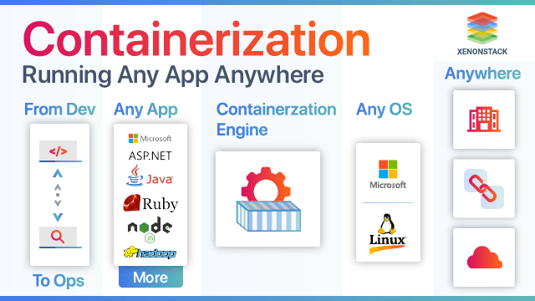

Slide 23
What are the benefits of containerization?
Developers use containerization to build and deploy modern applications because of the following advantages.
Portability
  Software developers use containerization to deploy applications in multiple environments without rewriting the program code.
  They build an application once and deploy it on multiple operating systems.
  For example, they run the same containers on Linux and Windows operating systems.
  Developers also upgrade legacy application code to modern versions using containers for deployment.

Slide 24
What are the benefits of containerization?
Scalability
  Containers are lightweight software components that run efficiently.
  For example, a virtual machine can launch a containerized application faster because it doesn't need to boot an operating system.
  Therefore, software developers can easily add multiple containers for different applications on a single machine.
  The container cluster uses computing resources from the same shared operating system, but one container doesn't interfere with the operation of other containers.

Slide 25
What are the benefits of containerization?
Fault tolerance
  Software development teams use containers to build fault-tolerant applications.
  They use multiple containers to run microservices on the cloud. Because containerized microservices operate in isolated user spaces, a single faulty container doesn't affect the other containers.
  This increases the resilience and availability of the application.

Slide 26
What are containerization use cases?
Cloud migration
  Cloud migration, or the lift-and-shift approach, is a software strategy that involves encapsulating legacy applications in containers and deploying them in a cloud computing environment.
  Organizations can modernize their applications without rewriting the entire software code.

Slide 27
What are containerization use cases?
Adoption of microservice architecture
  Organizations seeking to build cloud applications with microservices require containerization technology.
  The microservice architecture is a software development approach that uses multiple, interdependent software components to deliver a functional application.
  Each microservice has a unique and specific function.
  A modern cloud application consists of multiple microservices.
  For example, a video streaming application might have microservices for data processing, user tracking, billing, and personalization.
  Containerization provides the software tool to pack microservices as deployable programs on different platforms.

Slide 28
What are containerization use cases?
IoT devices
  Internet of Things (IoT) devices contain limited computing resources, making manual software updating a complex process.
  Containerization allows developers to deploy and update applications across IoT devices easily.

Slide 29
How does containerization work?
Containerization involves building self-sufficient software packages that perform consistently, regardless of the machines they run on.
Software developers create and deploy container images—that is, files that contain the necessary information to run a containerized application.
Developers use containerization tools to build container images based on the Open Container Initiative (OCI) image specification.
OCI is an open-source group that provides a standardized format for creating container images.
Container images are read-only and cannot be altered by the computer system.

Slide 30
How does containerization work?
Container images are the top layer in a containerized system that consists of the following layers.
Infrastructure
  Infrastructure is the hardware layer of the container model.
  It refers to the physical computer or bare-metal server that runs the containerized application.
Operating system
  The second layer of the containerization architecture is the operating system.
  Linux is a popular operating system for containerization with on-premise computers.
  In cloud computing, developers use cloud services such as AWS EC2 to run containerized applications.

Slide 31
How does containerization work?
Container engine
  The container engine, or container runtime, is a software program that creates containers based on the container images.
  It acts as an intermediary agent between the containers and the operating system, providing and managing resources that the application needs.
  For example, container engines can manage multiple containers on the same operating system by keeping them independent of the underlying infrastructure and each other.
Application and dependencies
  The topmost layer of the containerization architecture is the application code and the other files it needs to run, such as library dependencies and related configuration files.
  This layer might also contain a light guest operating system that gets installed over the host operating system.

Slide 32
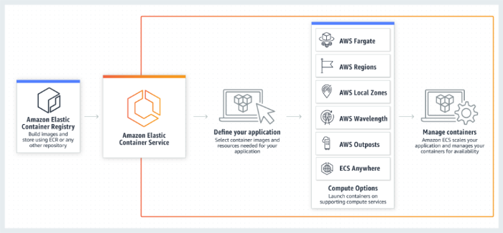
How does containerization work?

Slide 33
What are the types of container technology?
The following are some examples of popular technologies that developers use for containerization.
Docker
  Docker, or Docker Engine, is a popular open-source container runtime that allows software developers to build, deploy, and test containerized applications on various platforms.
  Docker containers are self-contained packages of applications and related files that are created with the Docker framework.

Slide 34
What are the types of container technology?
Linux
  Linux is an open-source operating system with built-in container technology.
  Linux containers are self-contained environments that allow multiple Linux-based applications to run on a single host machine.
  Software developers use Linux containers to deploy applications that write or read large amounts of data.
  Linux containers do not copy the entire operating system to their virtualized environment.
  Instead, the containers consist of necessary functionalities allocated in the Linux namespace.

Slide 35
What are the types of container technology?
Kubernetes
  Kubernetes is a popular open-source container orchestrator that software developers use to deploy, scale, and manage a vast number of microservices.
  It has a declarative model that makes automating containers easier.
  The declarative model ensures that Kubernetes takes the appropriate action to fulfil the requirements based on the configuration files.

Slide 36
Containerization compared to virtual machines
Containerization is a similar but improved concept of a VM.
Instead of copying the hardware layer, containerization removes the operating system layer from the self-contained environment.
This allows the application to run independently from the host operating system.
Containerization prevents resource waste because applications are provided with the exact resources they need.

Slide 37
What is serverless computing?
Serverless computing refers to a cloud computing technology where the cloud vendor fully manages the server infrastructure powering an application.
This means that developers and organizations do not need to configure, maintain, or provision resources on the cloud server.
Serverless computing allows organizations to automatically scale computing resources according to the workload.

Slide 38
Containerization compared to serverless computing
Serverless computing allows instant deployment of applications because there are no dependencies such as libraries or configuration files involved.
The cloud vendor doesn't charge for computing resources when the serverless application is idle.
Containers, on the other hand, are more portable, giving developers complete control of the application's environment.

Slide 39
What is cloud native?
Cloud native is a software development method that builds, tests, and deploys an application in the cloud.
The term cloud native means that the application is born and resides in a cloud computing environment.
Organizations build cloud-native applications because they are highly scalable, resilient, and flexible.

Slide 40
Containerization compared to cloud native
Cloud-native application development requires different technologies and approaches than conventional monolithic applications.
Containerization is one of the technologies that allows developers to build cloud-native applications.
It works with other cloud-native technologies, such as service mesh and APIs, to allow microservices to work cohesively in a cloud-native application.

Slide 41
What is AWS App2Container?
AWS App2Container is a containerization tool that allows software developers to modernize legacy applications.
Developers use App2Container to turn Java and .NET applications into containerized applications:
App2Container provides standard tools for migrating existing platform-based applications to the AWS environment.
With App2Container, developers are assured of security when scaling cloud applications.
Developers use App2Container to simplify identifying dependencies and configurations when creating container images.

Slide 42
What are Docker
Docker is a software platform that allows you to build, test, and deploy applications quickly.
Docker packages software into standardized units called containers that have everything the software needs to run including libraries, system tools, code, and runtime.
Using Docker, you can quickly deploy and scale applications into any environment and know your code will run.
Running Docker on AWS provides developers and admins a highly reliable, low-cost way to build, ship, and run distributed applications at any scale.

Slide 43
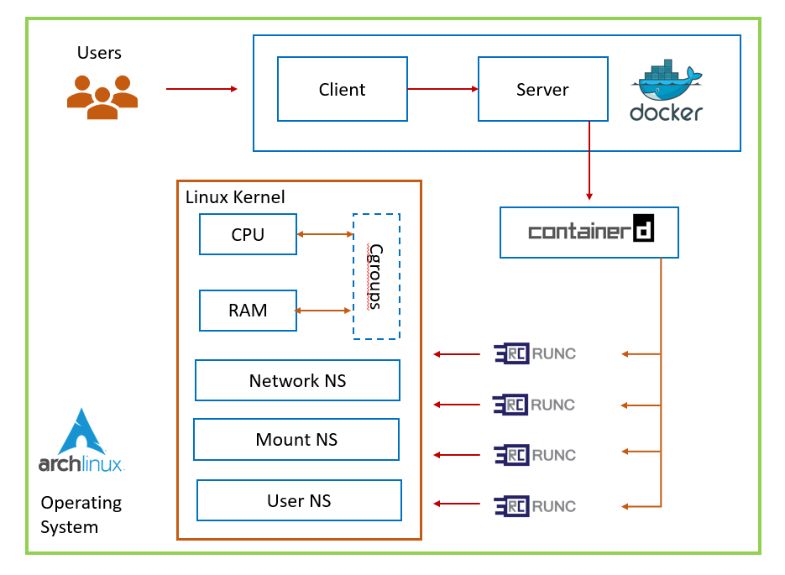

Slide 44
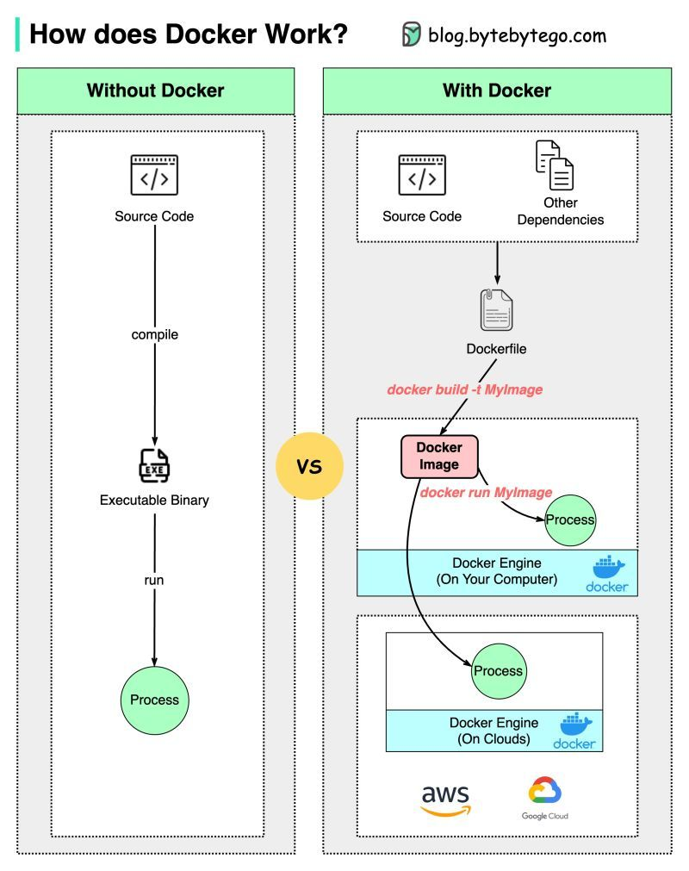

Slide 45
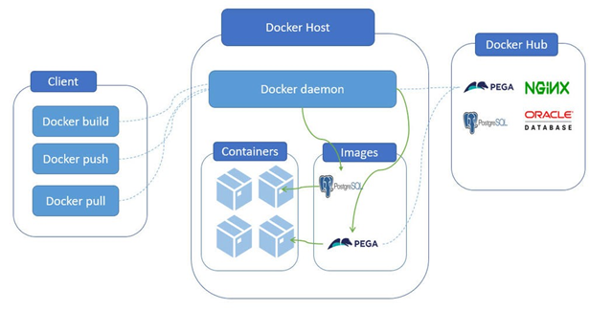

Slide 46
How Docker Works
Docker works by providing a standard way to run your code. Docker is an operating system for containers.
Similar to how a virtual machine virtualizes (removes the need to directly manage) server hardware, containers virtualize the operating system of a server.
Docker is installed on each server and provides simple commands you can use to build, start, or stop containers.
AWS services such as AWS Fargate, Amazon ECS, Amazon EKS, and AWS Batch make it easy to run and manage Docker containers at scale.

Slide 47
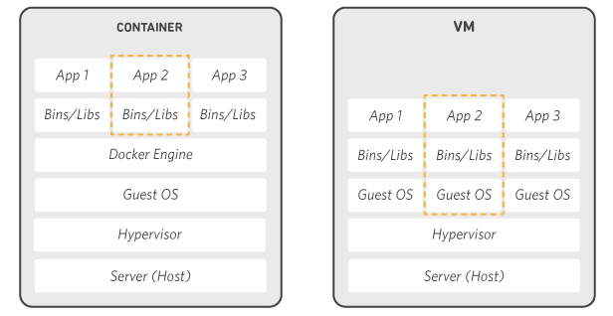
How Docker Works

Slide 48
Why Use Docker
Using Docker lets you ship code faster, standardize application operations, seamlessly move code, and save money by improving resource utilization.
With Docker, you get a single object that can reliably run anywhere. Docker's simple and straightforward syntax gives you full control.
Wide adoption means there's a robust ecosystem of tools and off-the-shelf applications that are ready to use with Docker.

